Slide 1
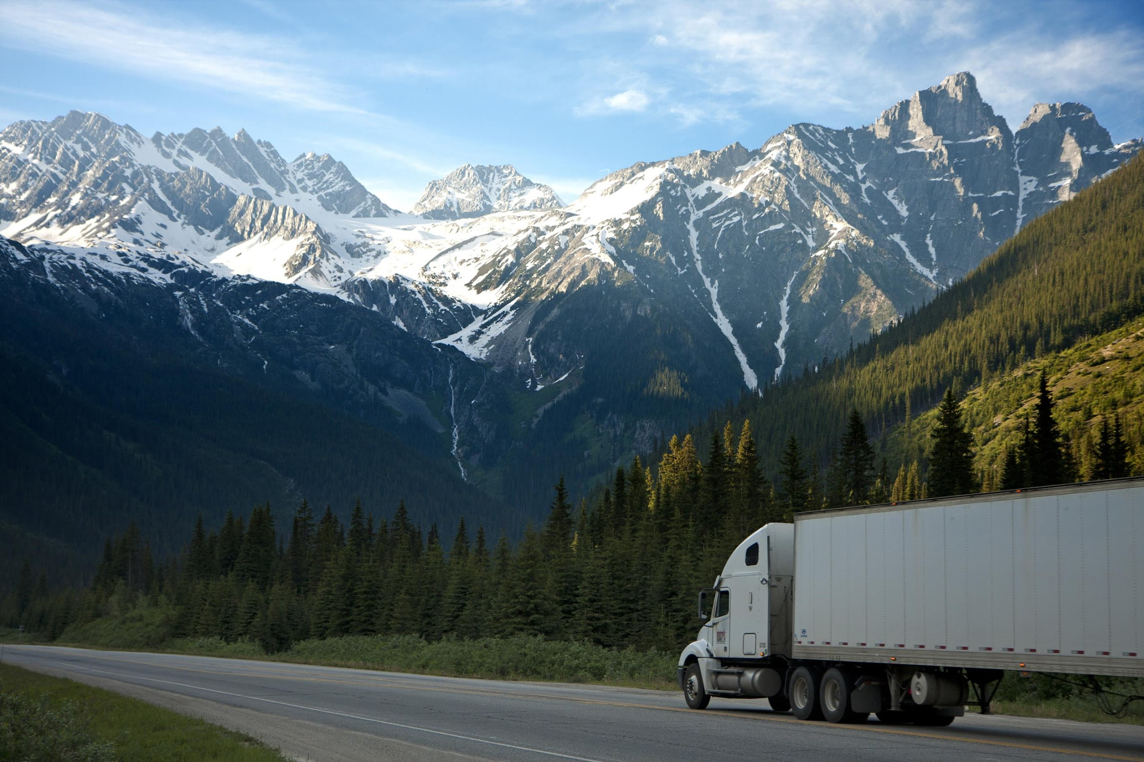
DYNAMIC ROUTE OPTIMIZATION AND EMISSION REDUCTION
SYSTEM
FedEX SMART Hackathon
KAMALESH PANDIAN
B.TECH AIML, 2021-2025
RAJALAKSHMI ENGINEERING COLLEGE,
Absolutely, Positively Anytime

Slide 2
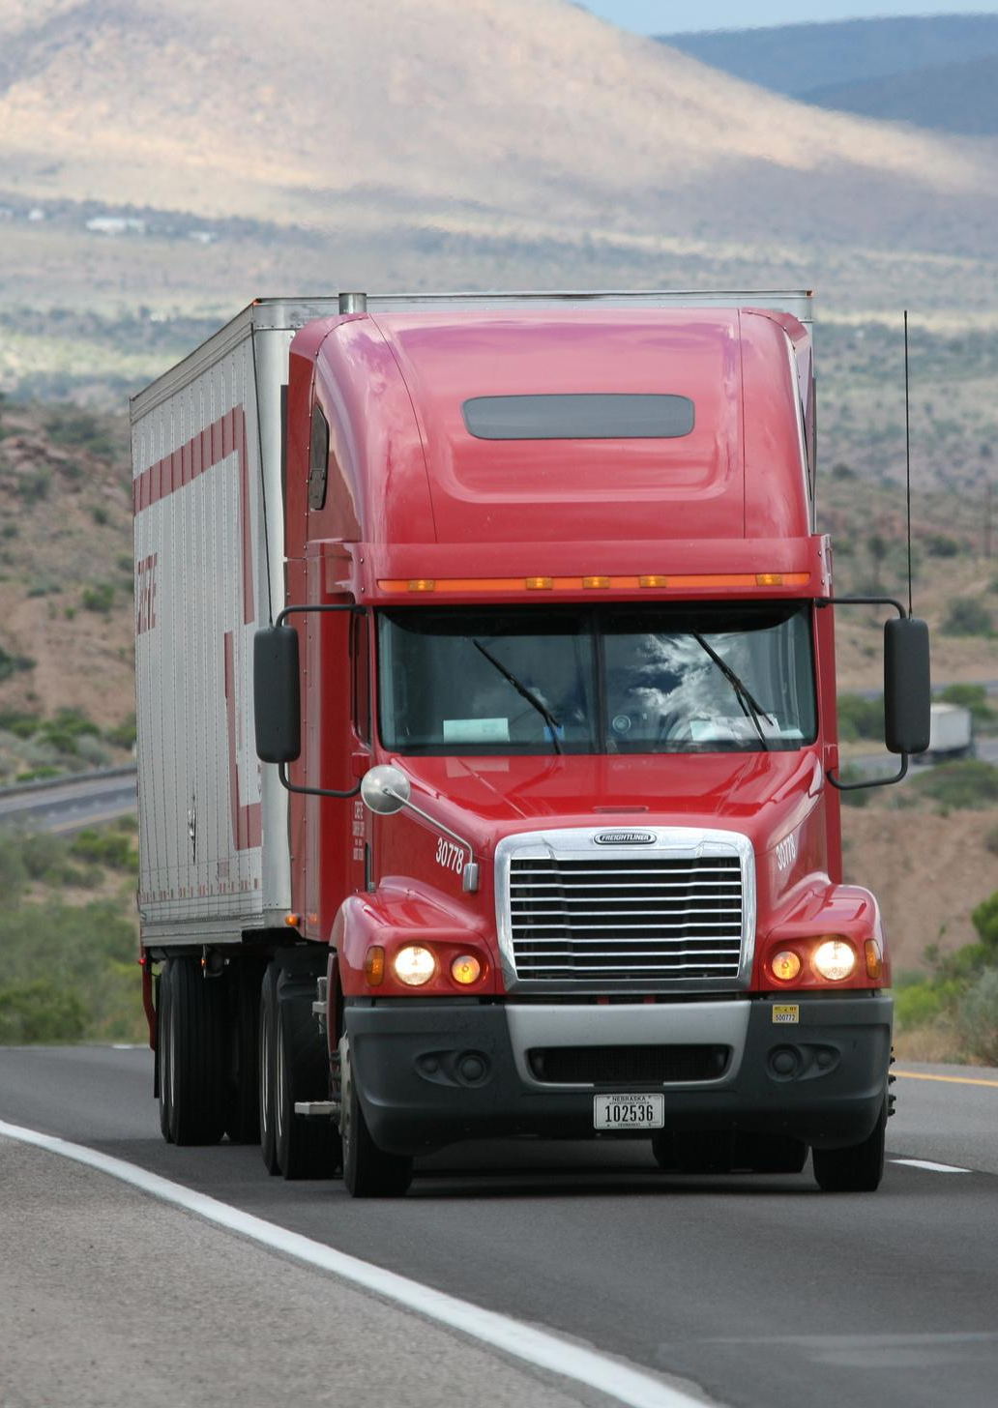
Problem Statement: Dynamic Route Optimization and Emission Reduction
System
Objectives:
• Develop a Python-based dynamic routing system using real-time data from various applicable APIs.
• Optimize vehicle routes considering traffic, weather, and vehicle-specific details.
• Estimate and minimize vehicle emissions for each route.
• Ensure the system is user-friendly and accessible

Slide 3
DATA SOURCES
Traffic Data: TomTom API - Provides real-time traffic updates, including congestion levels, incidents, and delays to enhance route planning.
Weather Data: OpenWeather API - Delivers current weather conditions, forecasts, and alerts to ensure safe and weather-aware navigation.
Air Quality Data: AQICN API - Supplies real-time air quality index (AQI) data to help avoid polluted areas and promote healthier travel.
Route Optimization: OSRM or GraphHopper API - Optimizes travel routes using real-time data, supporting multi-modal navigation and efficient path-finding.

Slide 4
ROUTING STRATEGY
FEATURE | LANDMARK-BASED ROUTING | CONTRACTION HIERARCHIES (CH)
CORE IDEA | Landmark-Based Routing pre-computes shortest paths from selected "landmark" nodes to all other nodes in the graph | Nodes are "contracted" (removed) from the graph while adding shortcuts that preserve shortest path distances.
Preprocessing Time | Moderate | High
Query Time | Fast | Extremely Fast
Flexibility (Dynamic Weights) | High | Low
Use Case | Dynamic, flexible routing with custom preferences, vehicle profiles, and last-mile delivery optimization. | Static, highly optimized pathfinding,static inter-hub logistics
Example | GraphHopper API Routing Supports O(k) preprocessing time to handle dynamic changes, where ‘k’ is the number of landmarks, making it effective for real-time updates. | OSRM API's CH Routing is faster for static queries O(log⁡n), but preprocessing is rigid, and require a full rebuild of the graph.

Slide 5
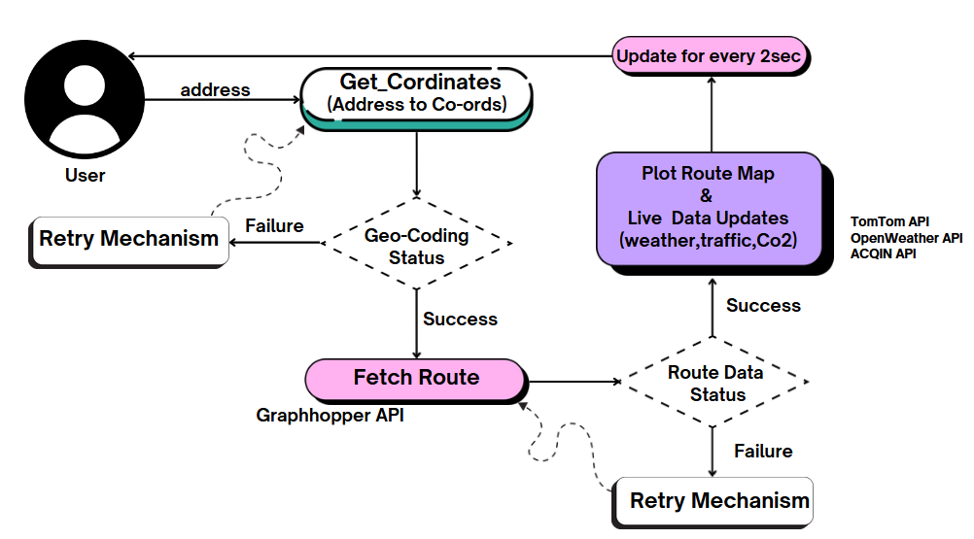
WORKFLOW DIAGRAM

Slide 6

GET COORDINATES
Helper Function: Get Coordinates with Retries and Error Handling
Objective:
Fetch geographical coordinates (latitude, longitude) for a given address using geocoding services.(geopy)
Handles retries and timeouts effectively.
Function workflow with the following steps:
Input address
Try geocoding → Timeout?
Yes: Retry (up to retries times, wait 2 seconds each time)
No: Return latitude, longitude
If all retries fail, log an error and return None.

Slide 7

DATA COLLECTION
Fetching Real-Time Data:
Objective:
Fetch real-time data: Weather, Air Quality, and Traffic information based on latitude and longitude.
Function workflow with the following steps:
For Real-Time Data:
Input: lat and lon.
Generate API URLs: Weather (OpenWeatherMap API),
Air Quality (AQI API),Traffic (TomTom API).
3.Send HTTP requests to APIs.
4.Process responses:
If success: Return weather, air quality, and traffic data.
If failure: Log error and return None.

Slide 8
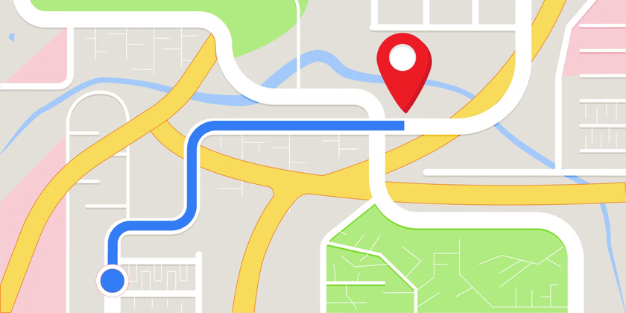
ROUTING DATA
Route Data with Error Handling:
Objective: Fetch route data: Calculate routes between start and end points for a specific vehicle type.
Function workflow with the following steps:
For Route Data:
Input: start_coords, end_coords, and vehicle_type.
Generate the route URL using GraphHopper API.
Send an HTTP request.
Process response:
If success (HTTP 200): Return JSON data with route information.
If failure: Log error and return None.

Slide 9
CALCULATE EMISSION
Calculate CO₂ emissions for a trip based on: Distance, Vehicle type,Real-time weather, air quality, traffic data and Load factor (e.g., weight carried by the vehicle).
1. Initialize Default Emission Factors: Base emission factors for different vehicle types:
Truck: 400 g CO₂/km
Small Truck: 300 g CO₂/km
Car: 150 g CO₂/km
Bike: 100 g CO₂/km
2. Adjust for Weather Conditions:
Wind Speed Adjustment = 1 + wind_speed * 0.03,it adjusts emissions based on wind speed.
Visibility Adjustment = 1 - (visibility / 10000), it adjusts emissions based on visibility

Slide 10
CALCULATE EMISSION
3. Adjust for Air Quality Index (AQI)
Adj.AQI : 1 + (max(aqi - 50, 0) / 100), AQI values greater than 50 increase emissions.
4. Adjust for Traffic Conditions:
Traffic Speed Adjustment = 1 + (1 - traffic_speed / free_speed), slower traffic speeds lead to higher emissions.
5. Adjust for Load Factor:
Load Factor Adjustment = 1 + 0.1 * (load_factor - 1) , higher load factors increase emissions.
6.Final Emissions
Emissions = base_emission * weather_adj * aqi_adj * traffic_adj * load_adj * (distance*1000)

Slide 11

LOAD FACTOR
Regulations for Load Factor:
FMCSA Regulations (49 CFR Part 393 - Cargo Securement):
Cargo must be properly secured to prevent shifting or falling during transit.
Load must not exceed the Gross Vehicle Weight Rating (GVWR) or axle weight limits of the vehicle.
Tiedown working load limits must equal at least 50% of the weight of the secured cargo.

Slide 12
LOAD FACTOR
Objective:
To ensure that vehicles carry loads within safe operational limits by matching the load to the vehicle's capacity. This is done using a 1-10 scale
Implementation of Load Factor:
Load Factor 1 (0-10% Capacity): Represents minimal loading; compliance is ensured by adhering to proper cargo securement (e.g., restraining loose items).
Load Factor 5 (40-60% Capacity): Medium loading; ensures balanced distribution and meets FMCSA securement requirements with properly rated tie-downs.
Load Factor 10 (90-100% Capacity): Maximum safe loading within vehicle GVWR and axle load limits, with all cargo secured as per FMCSA rules.

Slide 13
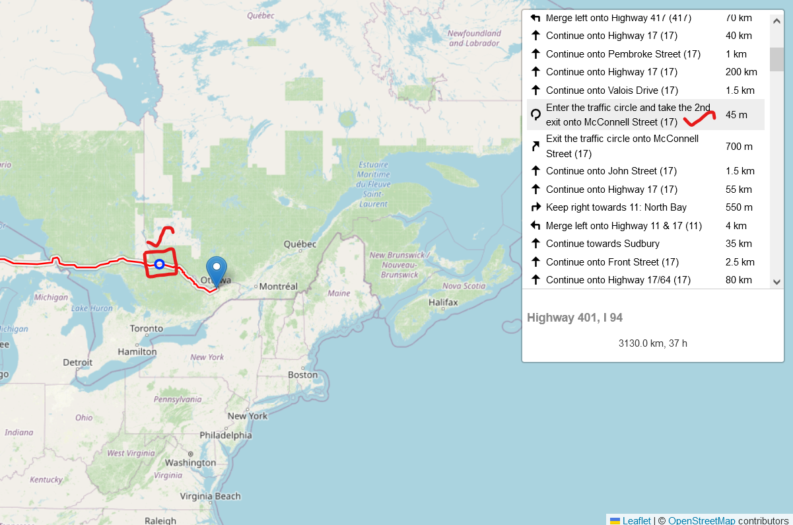
VEHICLE TRACKING SIMULATION

Slide 14
TRACKING LOGIC
Global Variables:
current_location: Holds the current position of the vehicle, starting with start_coords.
stop_tracking: A flag to control the termination of the tracking thread.
latest_updates: A dictionary to store the most recent data (location, weather, emissions, AQI, and traffic).
Simulate Vehicle Movement:
The vehicle progresses towards the destination by adjusting its latitude and longitude by a fraction (/10).
Tracking and Data Update with Controlled Termination:
The latest_updates dictionary is updated with the current location, weather, estimated emissions, AQI, and traffic data after each iteration.
The loop pauses for 2 seconds using time.sleep(2) before checking the stop_tracking flag to determine if it should terminate the tracking.

Slide 15
ROUTE MAPPING
Real-Time Route Mapping with Dynamic Markers
The function plot_route_map visualizes a route using folium on a map with markers representing key points.
Initializes a map centered at the start coordinates with zoom level 12.
Adds markers for the start , end and current location (blue).
Draws the route as a polyline with coordinates obtained from the route data, displaying the path with blue lines.
Returns the updated map for visualization.

Slide 16
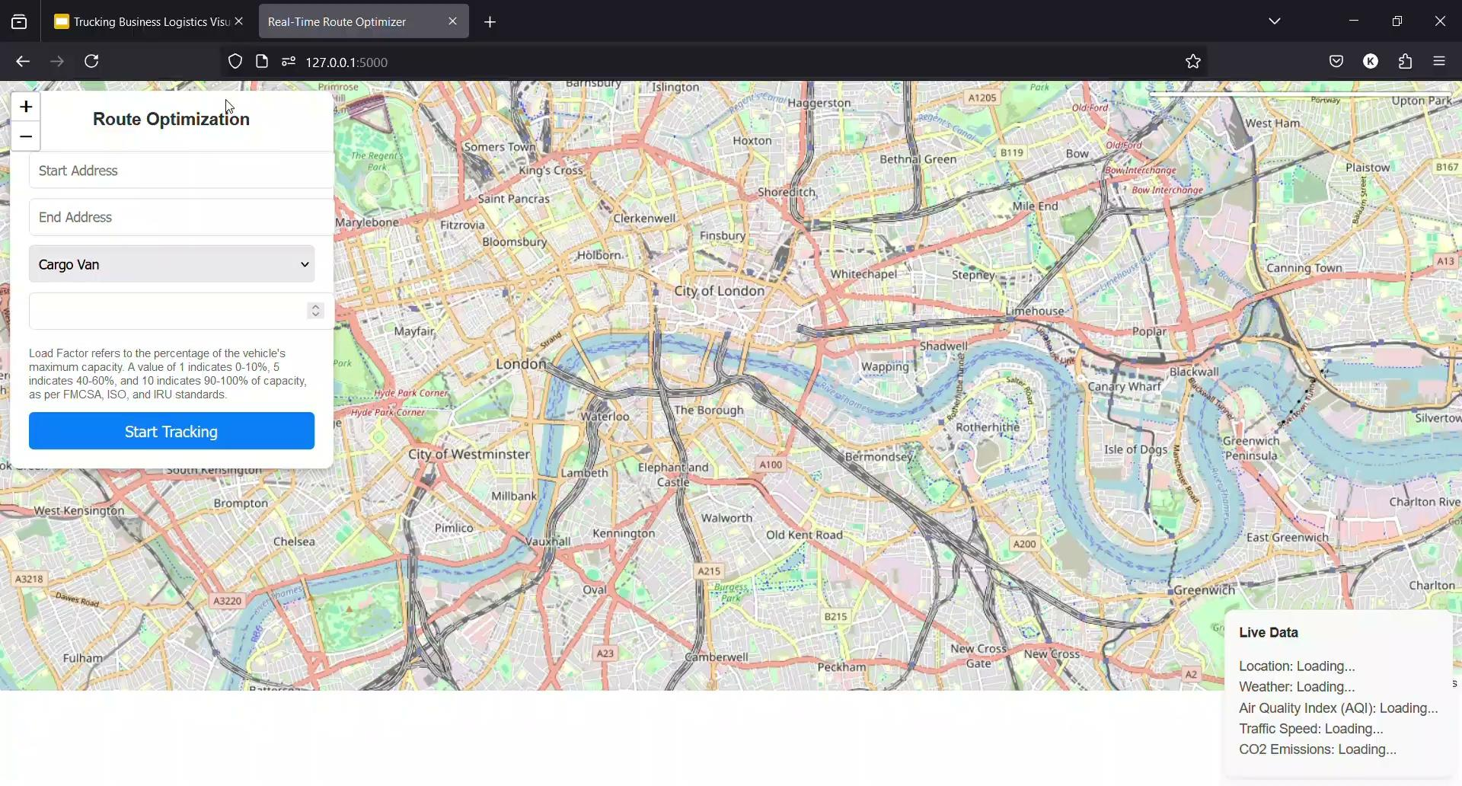

Slide 17
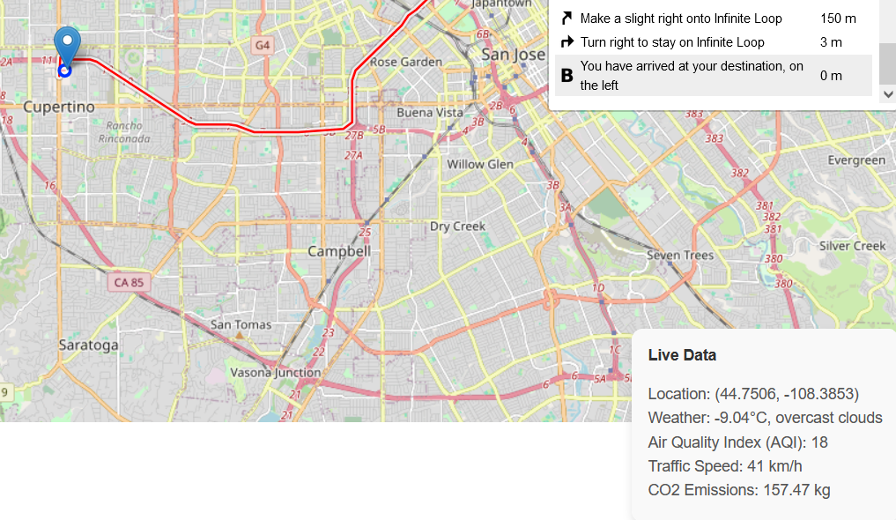
THE END

